Slide 1
Housing Lock-In Effect: Modeling Results
Two-level analysis: national time series (89 months) and state panel (50 states × 113 months)
Two models at each level: SARIMAX (parametric baseline) and XGBoost (nonlinear complement)
Primary outcome: monthly new listing count
Key predictors and covariates: lock-in premium (dL_c), unemployment (U_c), Home Price Index (HPI) (H_c), permits (dS), industry group

Slide 2
Data & Model Setup for SARIMAX
 | National Model | State Model
Training and Testing Data | 2016-08 to 2023-12 training, 2024-02 to 2025-12 test (22 months) | 4,450 training observations, 1,100 test observations across 50 states
SARIMAX Order | (0,1,1)×(0,1,1,12) | (1,1,1)×(2,1,1,12)
Assumption Violation | passes all residual diagnostics | violates residual independence and normality assumptions; treated as directional evidence only, not for inference

Slide 3
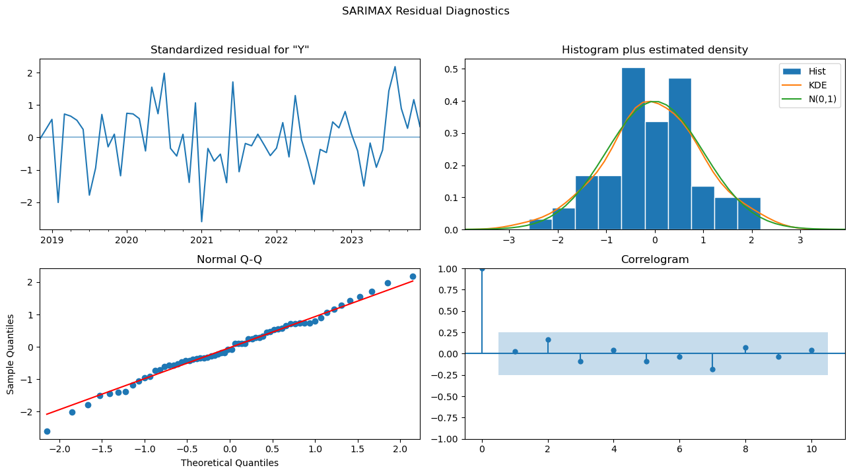
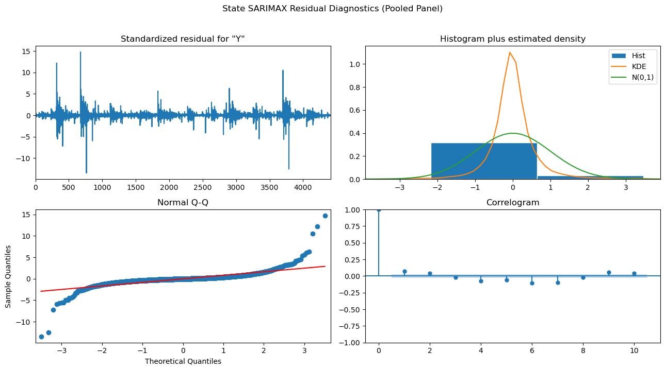
SARIMAX Residual Diagnostics
National: Ljung-Box p=0.82, JB p=0.92
— clean residuals, assumptions satisfied
State: Ljung-Box p=0.00, kurtosis=78.57, heteroskedasticity p=0.00
— all assumptions violated

Slide 4
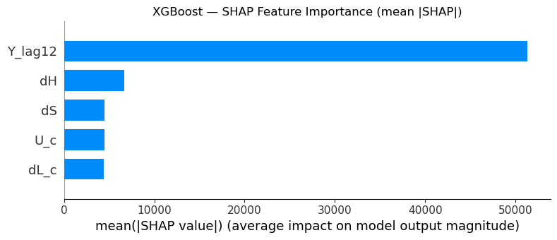
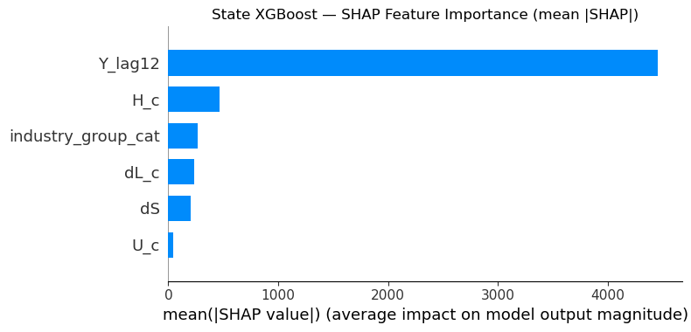
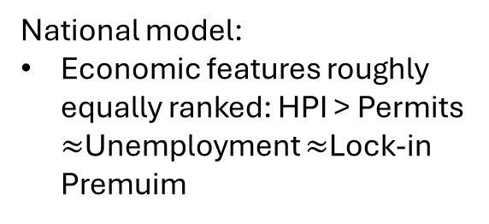
XGBoost: National vs State
National model:
Economic features roughly equally ranked: HPI > Permits $≈$Unemployment $≈$Lock-in Premuim
State model:
Lock-in Premuim rises to 4th overall (from last at national) — cross-state variation better identifies the lock-in signal
Industry Group ranks 3rd — industry structure is a genuine source of heterogeneity in listing activity
Unemployment drops to last — within-state unemployment variation over the study window is smaller than cross-time national variation
Common:
Seasonal factor dominates at both levels — seasonal memory is the primary driver of predictive accuracy

Slide 5
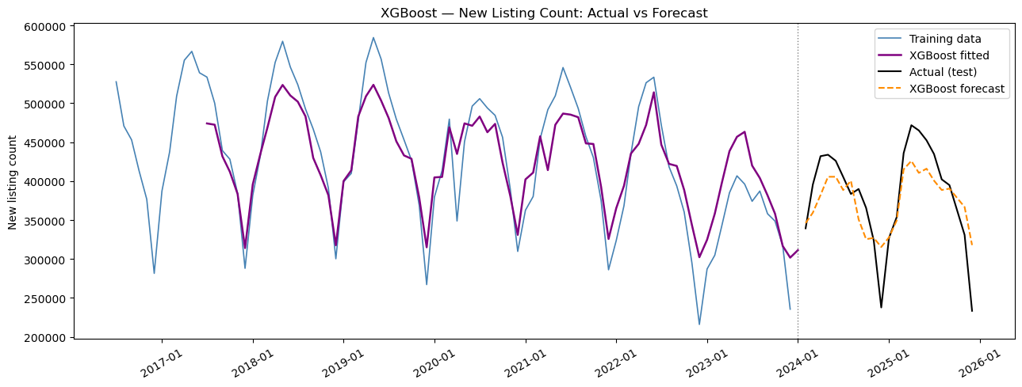
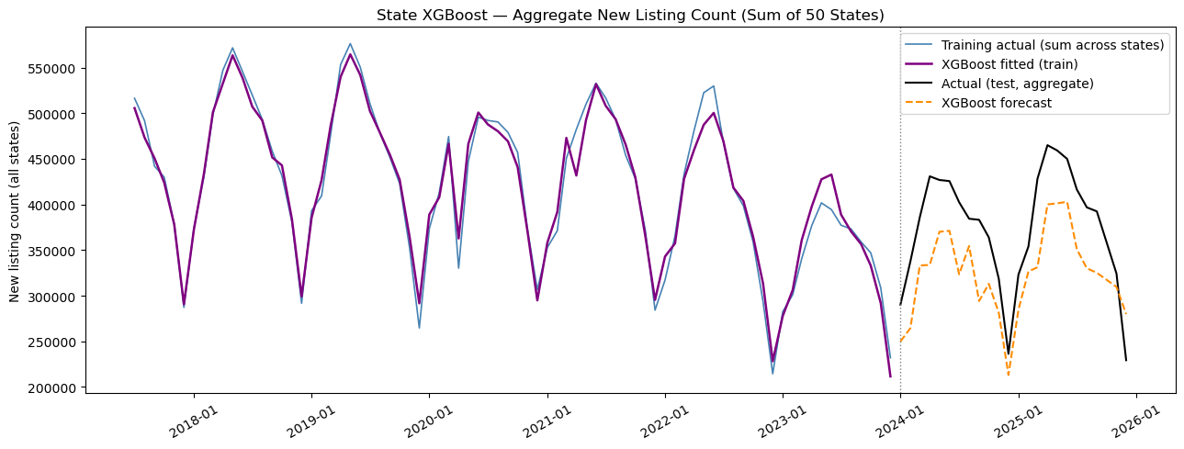
XGBoost: Forecasting
Both models track the seasonal pattern well in-sample
Out-of-sample: both levels miss the late-2024/2025 decline — consistent with an out-of-distribution episode with no training analog

Slide 6
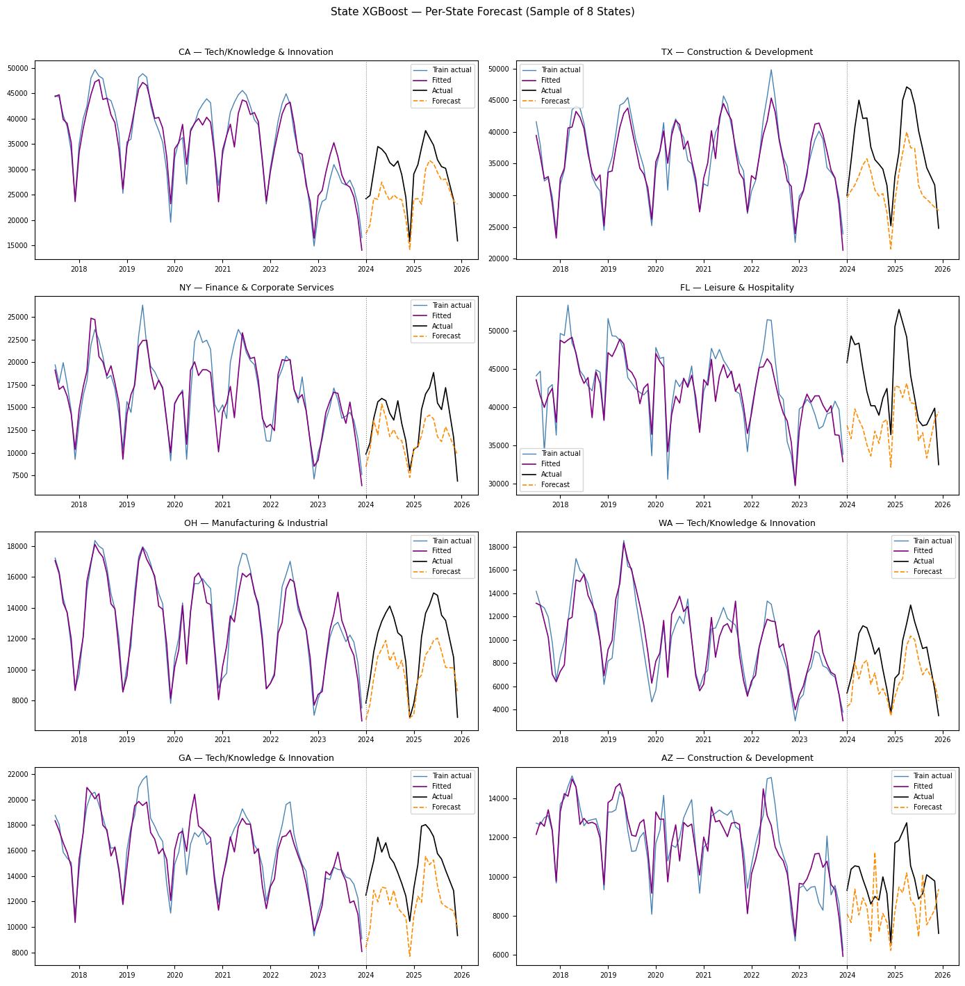
XGBoost: Forecasting
State model's per-state forecasts show reasonable fit for large states; small states with volatile listing counts show larger errors

Slide 7
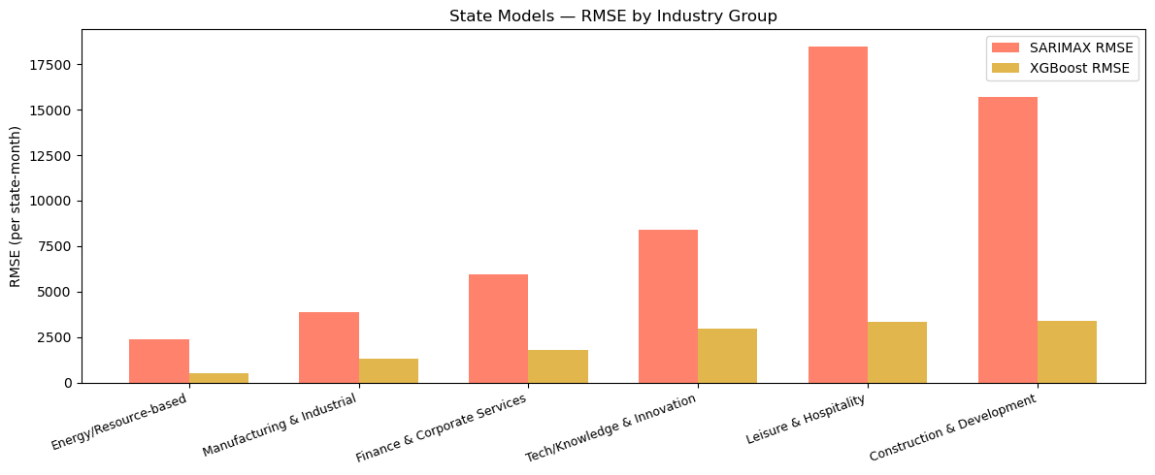
SARIMAX vs XGBoost
RMSE/MAE | SARIMA | XGBoost | Improvement
National | 58002.7/44465.3 | 37808.8/30501.2 | 35%
State | 8246.0/4736.6 | 2033.3/1237.1 | 75%
Performance gap reflects XGBoost's ability to capture nonlinear seasonal patterns via 12-month lag of New Listing Count (Y_lag12)
Industry group RMSE breakdown: prediction errors are not concentrated in any single group — the model generalises reasonably across industry structures

Slide 8
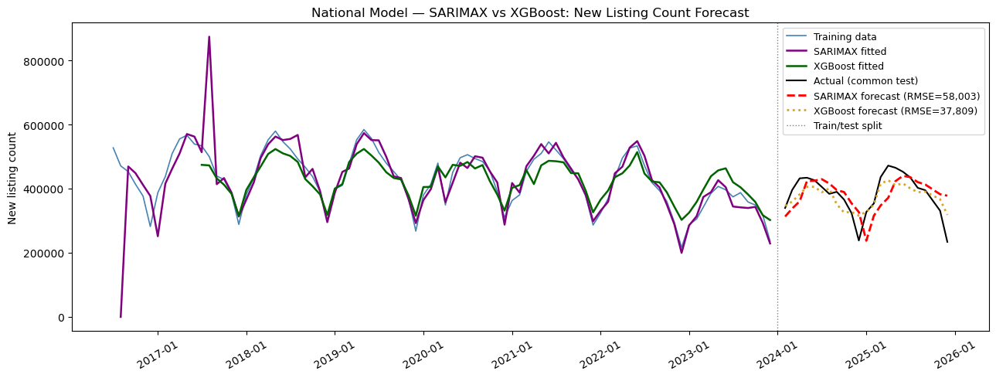
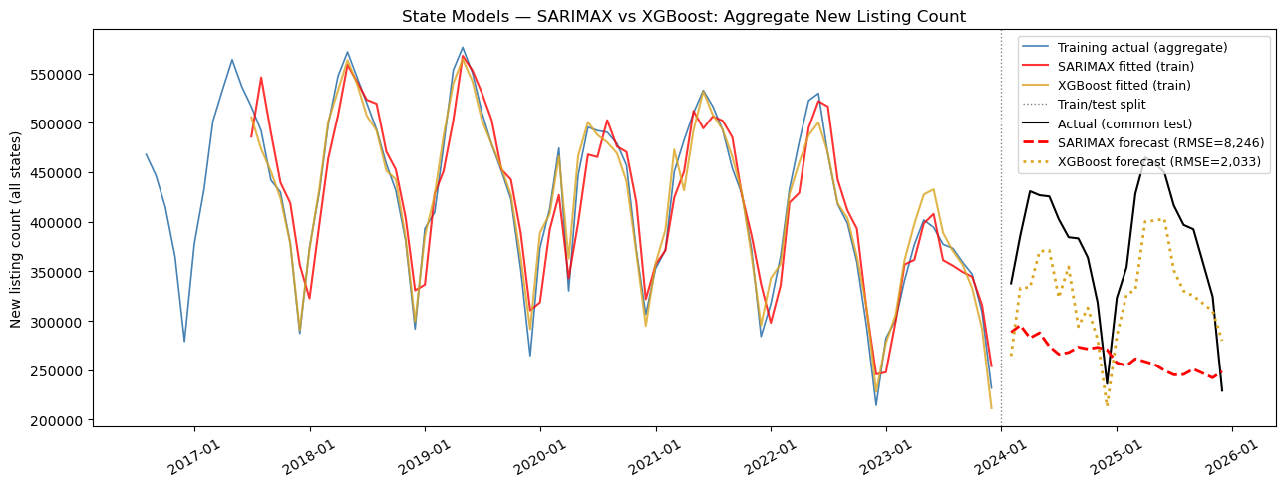
SARIMAX vs XGBoost in Forecasting

Slide 9
Conclusion
Unemployment suppresses listings — significant in national SARIMAX, state SARIMAX, and consistent with XGBoost SHAP direction; the most robust finding
Lock-in × unemployment interaction — negative and significant in state SARIMAX, directionally consistent in XGBoost; lock-in bites harder when labour markets are weak
Affordability constraint dominates — HPI negative and significant at state level; rising prices relative to a state's own baseline suppress rather than stimulate listings
Direct lock-in effect is weak in SARIMAX — insignificant at both levels; but SHAP importance rises substantially at the state level, suggesting a nonlinear effect XGBoost captures but SARIMAX cannot
Industry structure matters for baseline levels — Industry group are all significant; but the interaction between lock-in premium and industry groups are all insignificant — industry group modifies how many listings a state has, not how strongly lock-in suppresses them
State panel provides stronger identification — Interaction between lock-in premium and unemployment becomes significant only at the state level; cross-state variation is essential for identifying the unemployment amplification mechanism

